Slide 1
Navigating Change in a CRO – What I Wish I Knew 5 Years Ago About Transitioning to R
Sebastia Barcelo, 3rd July 2025
Notes:
Hello, my name is Sebastia Barcelo, and today I wanted to talk about how we are navigating the change to R in Cytel as a CRO, and what I wish I knew before starting to think about this transition.

Slide 2
Agenda
01
CRO needs
The CRO Challenge
Competing Priorities – One Shared Infrastructure
02
Building the Environment
Issue and solutions
What We Built – and What We’d Change
03
Training strategy
- Which type of training is needed?
04
Conclusions
Notes:
To do so, first of all I would like to talk a bit about our needs as a CRO, which kind of challenges we faced and the competing priorities when you try to build a unique environment for everyone.
Then, I will go into deeper detail about the process of building that environment, sharing some of the issues and solutions we had, and also talking a bit about what we did well under my point of view, and what we could have done better.
After that I will talk about our training strategy, and our thoughts about which type of training is needed.
Finally, I’ll share some conclusions about all this process.

Slide 3
01
CRO needs

Slide 4
The CRO Challenge
Multiple Clients
Each with their own processes, expectations, and validation requirements
Multiple Business Units (BUs)
RWE, Strategic Consulting, Project-based Teams
Different levels of R maturity and needs
Rapid Turnaround Projects
Tools must be ready “on-demand” with minimal setup time
Compliance & Flexibility Must Coexist
Need to allow external packages (CRAN, GitHub, client-supplied)
But also ensure reproducibility, audit trails, and SOP alignment
Notes:
Let’s start by talking about our challenges as a CRO.
First of all, we have multiple clients, which ever complicates a bit the processes, as some of them have their own processes, expectations and validation requirements.
We also have different Business Units, and there is a lot of variety between them. We have some Business units where R is barely used, and others where it’s used on a daily basis, for example, in RWE and Strategic Consulting.
This, combined with having multiple clients generates some rapid turnaround projects, where we need to be able to setup environments with a lot of flexibility and a minimal amount of time. And this is a bit complex if we want to be ablet o ensure reproducibility, remain aligned with SOPs and also have good traceability in front of an audit.
An example of this could be what we call “black box” studies. In this type of project, the client sends us the code, to run it in our validated environment, but this means that we have to be able to support multiple R versions, different versions of multiple packages, and also external packages from github or directly developed by the client.

Slide 5
Competing Priorities – One Shared Infrastructure
Infrastructure under pressure
Flexibility
Fast delivery
BU needs
Compliance
Reproducibility
IT constraints
Notes:
So, as you can see from this example, we have multiple competing priorities here. From one side, we need to be flexible, as we need to be able to support multiple versions of R and packages, we need to be able to do that fast, and also, Business Units as Strategic Consulting, needs to run simulations that requires a lot of computational power, and they need to be able to escalate the CPUs easily. All of this is a problem when we think about compliance and reproducibility, and it’s a headache for IT, as this puts the IT infrastructure under pressure.

Slide 6
02
Building the Environment
Notes:
So, how did we manage to build our environment to deal with this scenario?

Slide 7
Issues and Solutions
Integration Challenges
Rstudio Windows – Package Manager (cache)
SAS on Windows and POSIT on Linux
Data Storage and Workbench access
Dual Protocol Drives
Migration of folder permissions
Different instances of Connect for Internal vs External access
Pros: security, performance, compliance
Cons: integration, maintenance, cost
Notes:
Let me give you some background about how was our environment and why I would like to knew some of these things 5 years ago.
5 years ago I was still not part of Cytel, but they started the migration process from our previous version of SAS to SAS Grid, and based on the requirements they had at that moment, they decided to build the new SAS Grid environment on a Windows server. That was meaningful at that time, as that would avoid programs modification or data drives migrations, but a big mistake thinking about the headache generated by that lately.
This migration process was completed during 2023, the same year when we were starting to build our R environment. When we started to think about the requirements of this R environment, and given the challenges I mentioned before, it was clear for us, we had to go directly to the full set of tolos of POSIT: Workbench Package Manager and Connect. But those tools are Linux based, and this was a problem.
Our data drives couldn’t be accessed from Linux servers. So, to ensure gaining time for a smooth transition (already thinking about potential unknown issues generated due to that), we decide to add Rstudio Windows app to the list of requirements, which was again another tool to validate, and to be managed by IT, and also with new issues, because even if there is no problem accessing package manager from Linux, that generated some extra issues associated to how packages are saved in the cache. But this is a minor issue compared with the rest.
To solve the issue related with Data Storage, and how to Access them from Workbench, we had to migrate the projects to Dual Protocol Drives. This type of drives allows Access from both, Windows and R at the same time, so this would let us use SAS and R on the same Project. But there were also issues with this, as the folder permissions couldn’t be migrated automatically from the old drives to this ones, so, that permission migration had to be done manually for the selected projects, but obviously this is time and resource consuming.
Finally, in terms of infrastructure, we wanted to deal with the situation of building Shiny Applications for internal either external Access. To do so, we decided to have 2 different instances for this, because even if this requires more maintenance and some extra cost, allows us to ensure that it’s easier to handle the security Access, that the performance of one instance won’t impact the performance of the other, which could impact the POSIT Workbench work of our stakeholders, and it’s also easier to remain compliant with our IT processes.

Slide 8
What We Built – and What We’d Change
What Worked:
What We’d Do Differently Now:
Central Package Management: Internal CRAN-like repo for tested/approved packages
Automated Package Scanning: To speed up validation of open-source packages
Whitelisting Strategy: SMEs could approve new packages after review
Creation of CytelProjects
Adoption of Containerization: Easier reproducibility and rollback
BU-specific SMEs for package review and approval
Independent curated repositories per BU
Start pilot studies earlier: It would help to define ealier environment gaps and the needed trainings
Notes:
But, even with the issue we had, we were finally able to put in place a robust environment that allows us to deal with all the challenges we mentioned, but we are still leaving the door opened to potential modifications.
Putting in place all the POSIT tools, centralizing the package management in Package Manager, with the creation of a curated repository was key. And to do that, having a very small team of SME, it was really important to put in place and automatic process for package scanning and metadata extraction. Right now this can be done with public packages like risk.assessr, but 2 years ago, riskmetrics was not able to extract all the information we wanted to use for our package risk assessment. And having Access to this metadata was key in the whitelisting strategy to approve new packages, as our SMEs on this área were very few, and only from one department. We also created an internal package, CytelProjects, that allows us to deal with the packages that we allow to use for the different tasks accross the different Bus, which gives us the flexibility and traceability we needed to cover our needs.
But, even if this worked, there are few things that we would do differently if we had to start right now. We would explore more the use of containers, as they facilitate the reproducibility of the environment for submissions. Another thing that probably would Help to that, is to have BU specific SME dealing with the package review of their BU, and adding them to an independent curated repository per BU. As we have different needs, sometimes is complex to find agreements about if we should include or not a package, or how Deep should we go in the risk assessment.
And finally, and I think this is the most important for me, I would start with pilot studies earlier. Doing pilot studies, even if you don’t have your final environment would Help you to identify environment needs or issues before, so, you would have more time to fix them. That would also Help you to identify the specific needs of training, and to have larger groups of SMEs, which would facilitate the transition and adoption of R.

Slide 9
03
Training strategy
Notes:
Because If we want to put in place a new environment and a new programming language, we Will have to train the people. So, which training strategy should we follow?

Slide 10
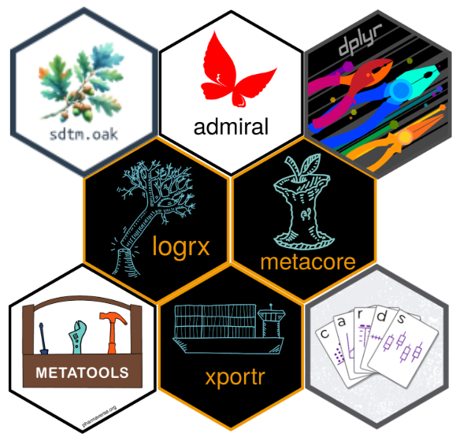
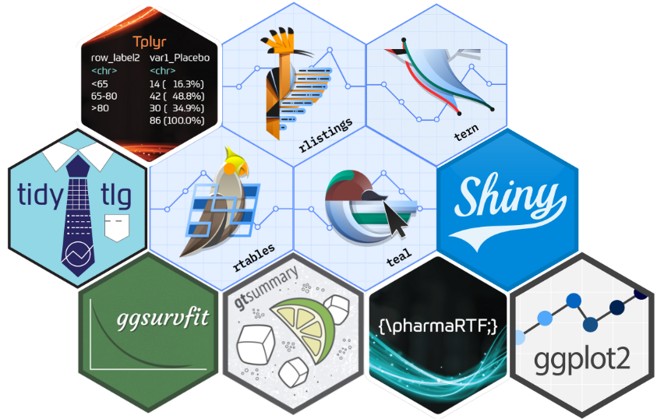
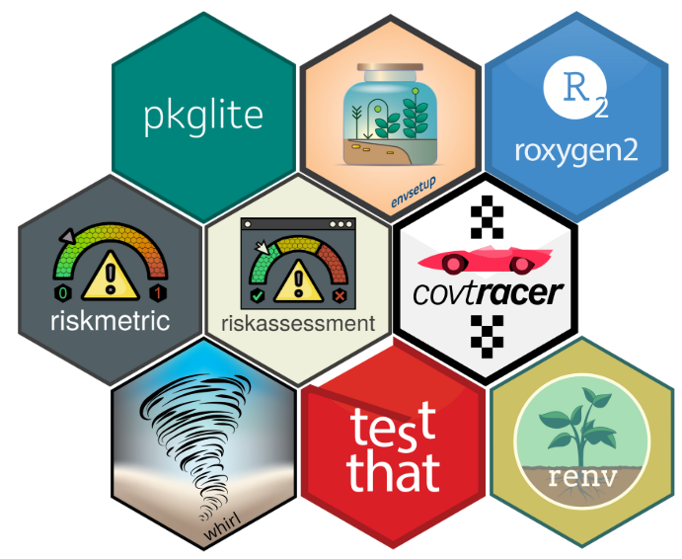
Which type of training is needed?
Notes:
First of all, we should think about which type of training is needed.
There are thousands of R packages, but obviously not everyone needs to know everything. For example, at the center of this slide, we have some packages which main goal is to deal with the package creation and environment setup. Probably only a reduced group of people needs to be really trained on them. On the top left, we have packages related to data manipulation, so, probably everyone who Works on SDTM-ADAM-TLFs needs to be trained on that, or maybe, they already know how to do it. But probably not all those package are needed for biostatisticians who only wants to use R for Biostats Review of the outputs, in that case, the packages from the right side would be much more interesting for them.
So, when we started to think about this, another question poped up…

Slide 11
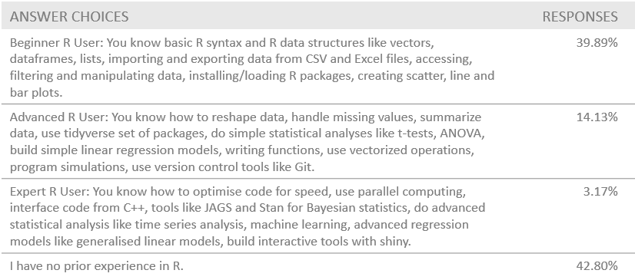
Do you know the skills of your team (all)?
Notes:
Do we really know the skills of our teams? And the answer to that was a clear NO.
So, we decided to do a survey accross different departments and we confirmed what we thought. A lot of people had no prior experience in R, a another huge portion considered themselves as begginers.
In this survey, we were going into deeper details about the departments, roles and specific skills, for example…

Slide 12
Do you know the skills of your team (all)?
Notes:
Asking them to confirm if they had real experience using specific packages or tools. Going from basic data manipulation with Dplyr, statistical modelling and data visualization, or Machine Learning and Git.

Slide 13
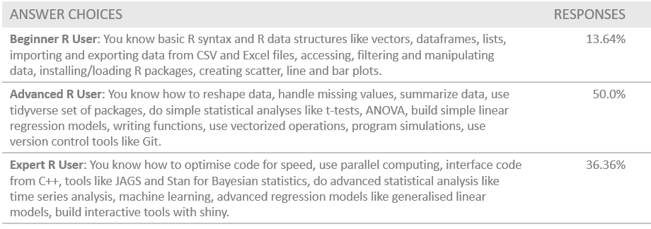
Is there a lot of deviation accross BUs?
Notes:
But not all teams have the same level of Skills. For example, to the same questions, the level of knowledge in our Strategic Consulting team was clearly above the other BUs. So, obviously the type of training they need is completely different to a BU where 40% of the people have no prior R knowledge.

Slide 14
Building R Champions First – Then Scaling
SMEs
Small Group Sessions
Wider Adoption
Culture Shift
Notes:
So, based on that, our training strategy was clear, let’s build R champions first. Then scaling.
We started with a very strong and reduced team of SMEs, who participated in the creation and validation of the environment, to put in place the internal R packages to support that, to do the risk assessment of the package and to define the training needs for each department.
Then, for the departments where the knowledge was more limited, we started by small group sessions, and just after that, letting the people work on pilot studies, and collecting lessons learnt from that work. In some departments we are still at this stage.
Then in other departments, it was easier to move faster, and the training needed was very minimal to ensure a wider adoption of the new tolos and processes to make the culture shift real.

Slide 15
04
Conclusions

Slide 16
Conclusions
Think well the needs of your environment and share them with IT before taking decisions
flexibility, reproducibility
Windows vs Linux
Containers…
Starting pilots earlier will help you to avoid problems later
Take advantage of public packages to build your environment (renv, testthat, covr…)
Confirm the knowledge of your team, and design the appropriate training strategy accoring to that
Notes:
To conclude, I would just like to focus on few takeaways.

Slide 17
Thank you!

